Slide 1
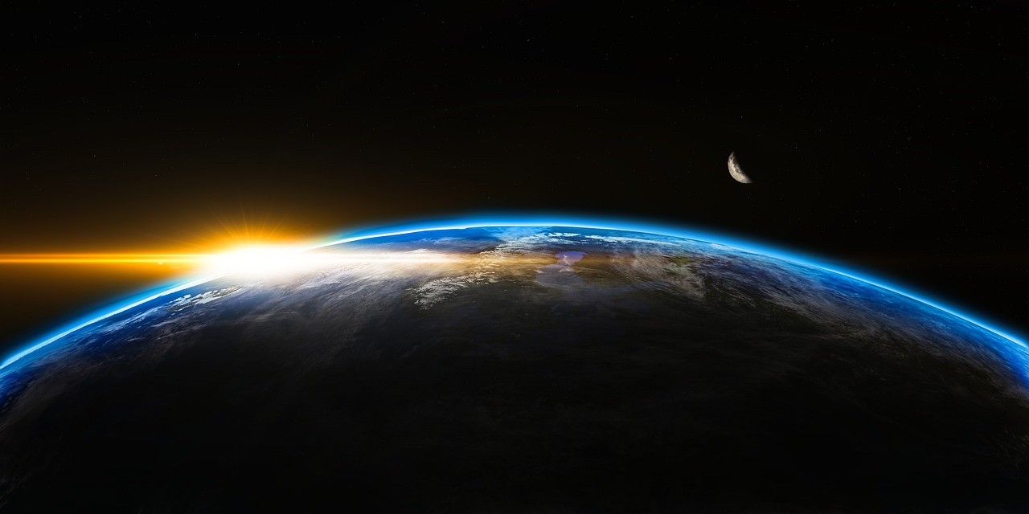
“For God so loved the world, that he gave his only Son, that whoever believes in him should not perish but have eternal life.
John 3:16

Slide 3
What is “Eternal Life”?

Slide 4
What is “Eternal Life”?
Set in contrast with:
  “Perish”
  “Condemn”

Slide 5
What is “Eternal Life”?
Set in contrast with:
  “Perish”
  “Condemn”
Equivalent to:
  “Saved”

Slide 6
What is “Eternal Life”?
The easy answer:
  Living forever

Slide 7
What is “Eternal Life”?
The easy answer:
  Living forever
  EVERYONE will live forever

Slide 8
What is “Eternal Life”?
The easy answer:
  Living forever
  EVERYONE will live forever
Matthew 25:46
"And these will go away into eternal punishment, but the righteous into eternal life.”

Slide 9
What is “Eternal Life”?
“Of course, eternal life in heaven.”

Slide 10
What is “Eternal Life”?
“Of course, eternal life in heaven.”
  The gift is not simply in the future

Slide 11
What is “Eternal Life”?
“Of course, eternal life in heaven.”
  The gift is not simply in the future
John 5:24
Truly, truly, I say to you, whoever hears my word and believes him who sent me has eternal life. He does not come into judgment, but has passed from death to life.

Slide 12
What is “Eternal Life”?
“Of course, eternal life in heaven.”
  The gift is not simply in the future
John 6:47
Truly, truly, I say to you, whoever believes has eternal life.

Slide 13
What is “Eternal Life”?
“Of course, eternal life in heaven.”
  The gift is not simply in the future
  People don’t want to go to hell…

Slide 14
What is “Eternal Life”?
“Of course, eternal life in heaven.”
  The gift is not simply in the future
  People don’t want to go to hell…
  But they aren’t thrilled with going to heaven!

Slide 15
John 17:1-5
When Jesus had spoken these words, he lifted up his eyes to heaven, and said, “Father, the hour has come; glorify your Son that the Son may glorify you,² since you have given him authority over all flesh, to give eternal life to all whom you have given him. ³ And this is eternal life, that they know you, the only true God, and Jesus Christ whom you have sent. ⁴ I glorified you on earth, having accomplished the work that you gave me to do. ⁵ And now, Father, glorify me in your own presence with the glory that I had with you before the world existed.

Slide 16
John 17:1-5
When Jesus had spoken these words, he lifted up his eyes to heaven, and said, “Father, the hour has come; glorify your Son that the Son may glorify you,² since you have given him authority over all flesh, to give eternal life to all whom you have given him. ³ And this is eternal life, that they know you, the only true God, and Jesus Christ whom you have sent. ⁴ I glorified you on earth, having accomplished the work that you gave me to do. ⁵ And now, Father, glorify me in your own presence with the glory that I had with you before the world existed.

Slide 17
It is Knowing God and Christ

Slide 18
It is Knowing God and Christ
“Know”
  Deep intimacy (Genesis 4:1)
  Personal experience

Slide 19
It is Knowing God and Christ
“Know”
  Deep intimacy (Genesis 4:1)
  Personal experience
Psalm 42:1
As a deer pants for flowing streams, so pants my soul for you, O God. My soul thirsts for God, for the living God; When shall I come and appear before God?

Slide 20
It is Knowing God and Christ
“Know”
  Deep intimacy (Genesis 4:1)
  Personal experience
Psalm 73:25
Whom have I in heaven but you?
And there is nothing on earth that I desire besides you.

Slide 21
It is Knowing God and Christ
Jeremiah 9:23-24
Thus says the Lord: “Let not the wise man boast in his wisdom, let not the mighty man boast in his might, let not the rich man boast in his riches, but let him who boasts boast in this, that he understands and knows me, that I am the Lord who practices steadfast love, justice, and righteousness in the earth. For in these things I delight, declares the Lord.”

Slide 22
It is Knowing God and Christ
It means knowing God

Slide 23
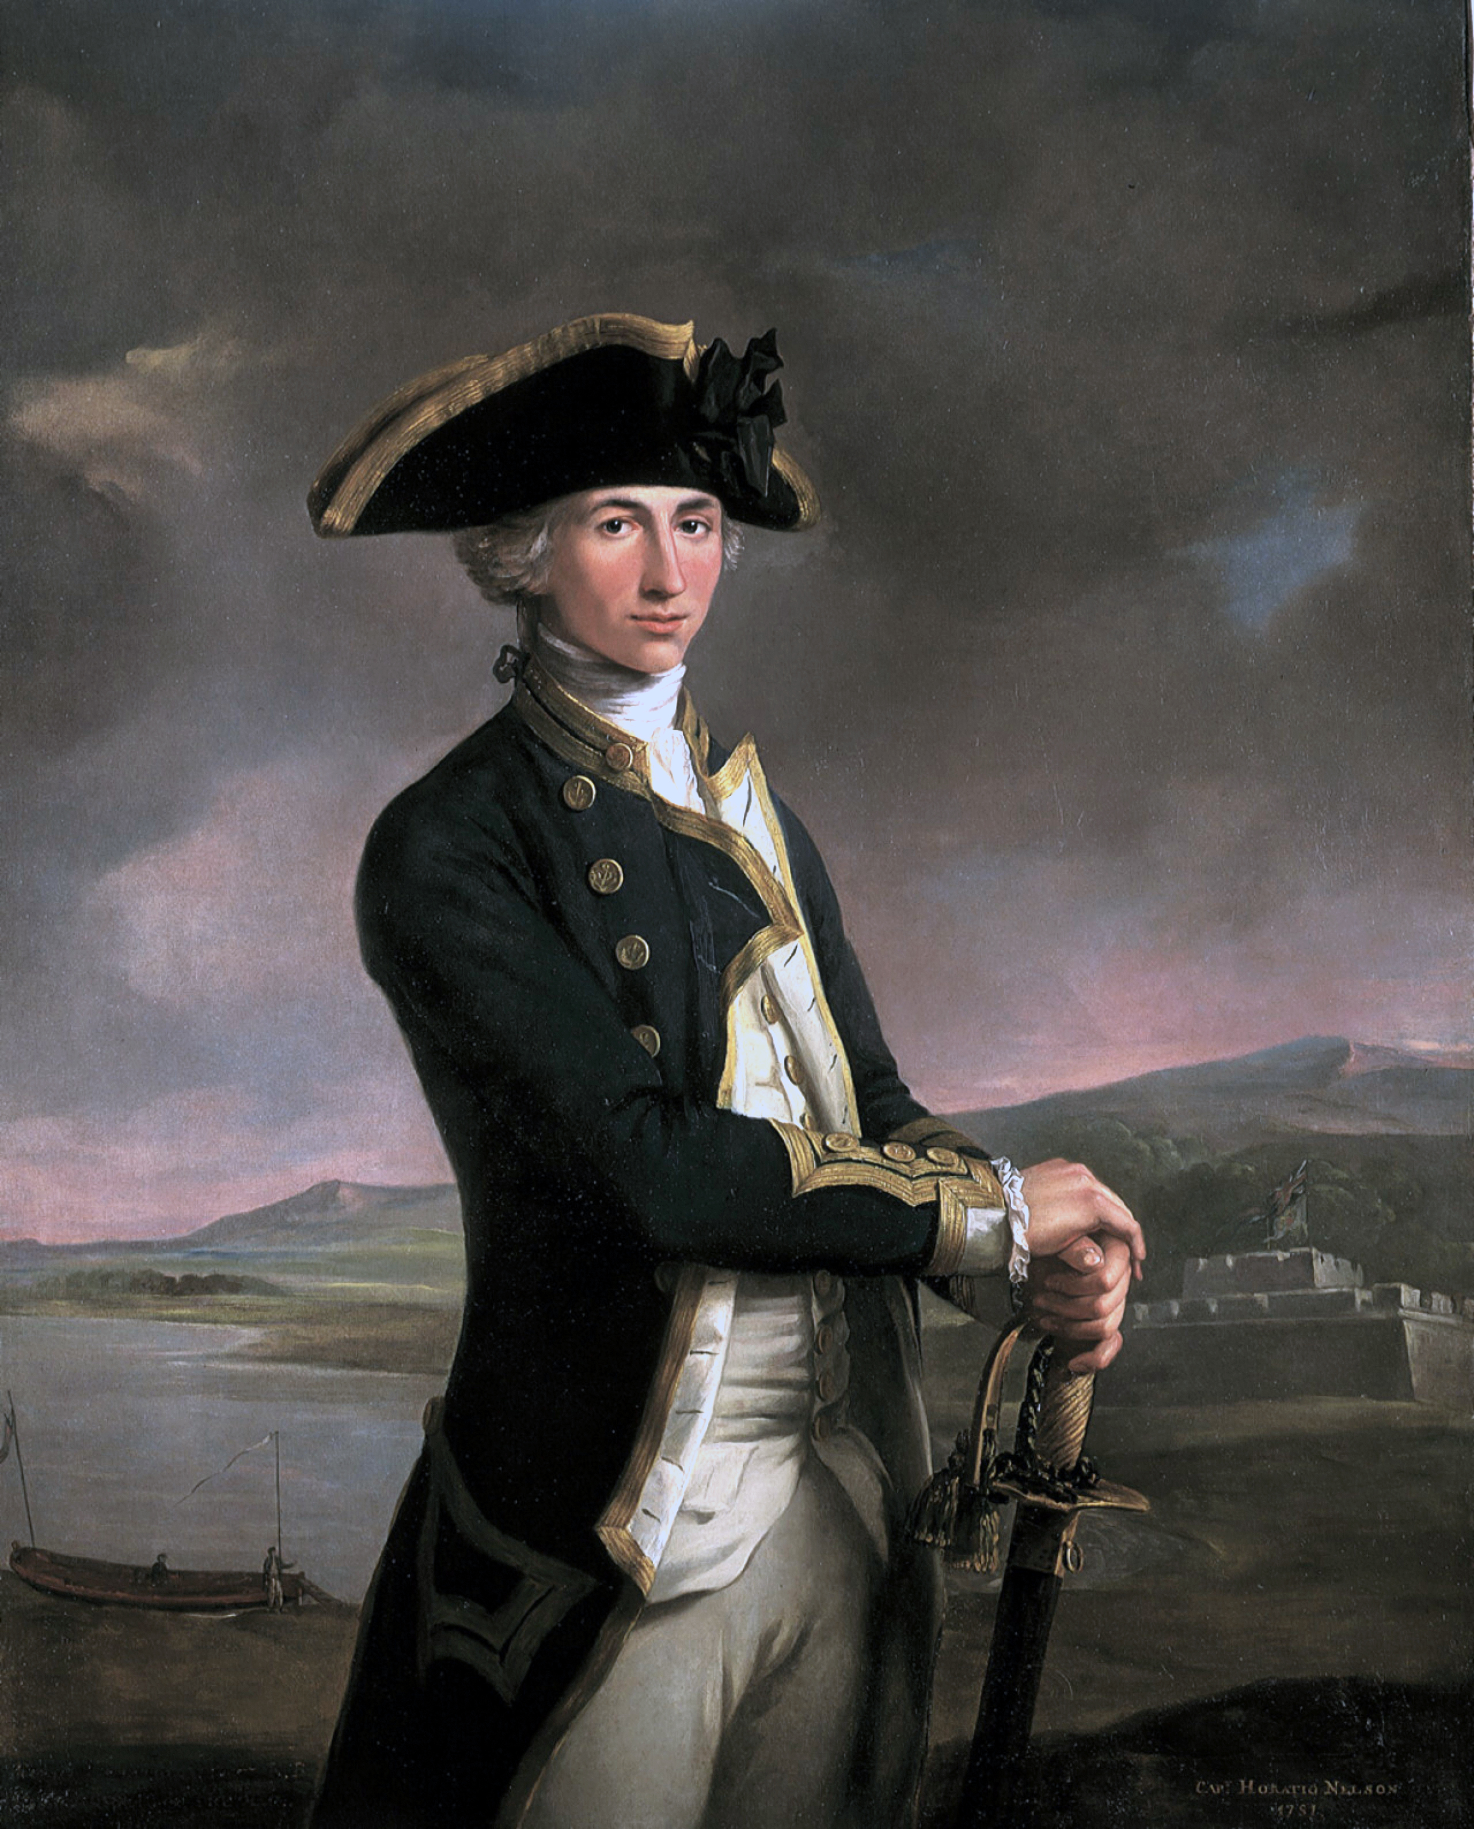
It is Knowing God and Christ
It means knowing God

Slide 24
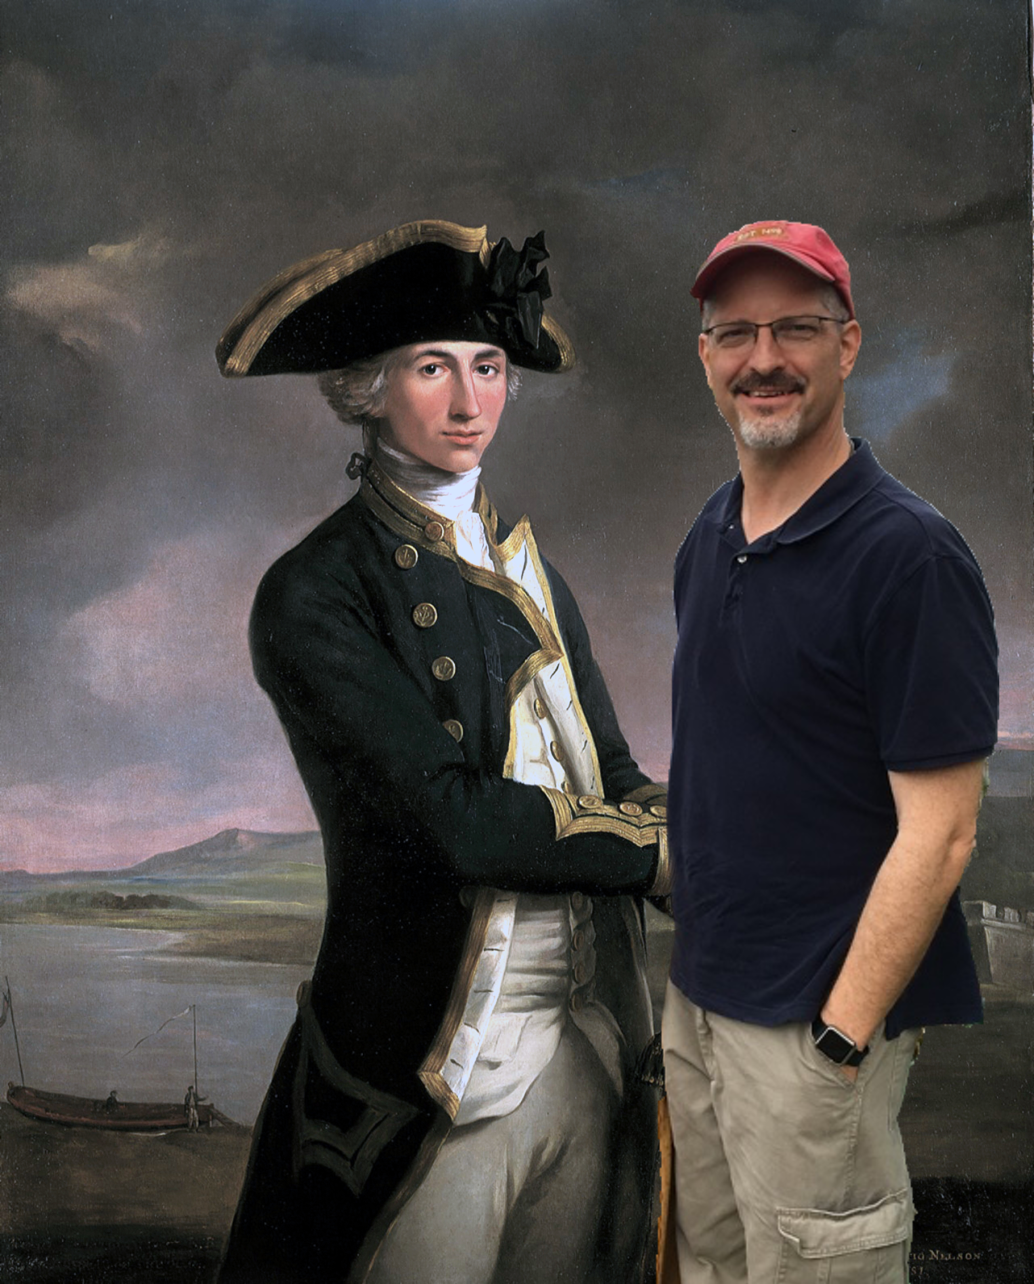
It is Knowing God and Christ
It means knowing God

Slide 25
It is Knowing God and Christ
It means knowing God
  Jesus modeled this

Slide 26
It is Knowing God and Christ
It means knowing God
  Jesus modeled this
John 10:30
“I and the Father are one.”

Slide 27
It is Knowing God and Christ
It means knowing God
  Jesus modeled this
Matthew 11:27
All things have been handed over to me by my Father, and no one knows the Son except the Father, and no one knows the Father except the Son and anyone to whom the Son chooses to reveal him.

Slide 28
It is Knowing God and Christ
It means knowing God
It means knowing Jesus

Slide 29
It is Knowing God and Christ
It means knowing God
It means knowing Jesus
John 1:1
In the beginning was the Word, and the Word was with God, and the Word was God.

Slide 30
It is Knowing God and Christ
It means knowing God
It means knowing Jesus
John 1:14
And the Word became flesh and dwelt among us, and we have seen his glory, glory as of the only Son from the Father, full of grace and truth.

Slide 31
It is Knowing God and Christ
It means knowing God
It means knowing Jesus
John 14:9-10
Jesus said to him, “Have I been with you so long, and you still do not know me, Philip? Whoever has seen me has seen the Father. How can you say, ‘Show us the Father’?

Slide 32
It is Knowing God and Christ
It means knowing God
It means knowing Jesus
  Amazed at His invitation (Mt. 11:28-30)
  His teachings (Mt. 5-7)
  His compassion (8:1-3)
  His sacrifice

Slide 33
It is Knowing God and Christ
It means knowing God
It means knowing Jesus
Eternal life is about accepting a relationship with the Father/Christ

Slide 34
It is Knowing God and Christ
It means knowing God
It means knowing Jesus
Eternal life is about accepting a relationship with the Father/Christ
  It isn’t about a destination

Slide 35
It is Knowing God and Christ
John 14:1-3
“Let not your hearts be troubled. Believe in God; believe also in me. In my Father's house are many rooms. If it were not so, would I have told you that I go to prepare a place for you? And if I go and prepare a place for you, I will come again and will take you to myself, that where I am you may be also.”

Slide 36
It is Knowing God and Christ
Revelation 21:22-23
And I saw no temple in the city, for its temple is the Lord God the Almighty and the Lamb. And the city has no need of sun or moon to shine on it, for the glory of God gives it light, and its lamp is the Lamb.

Slide 37
How Do I Know God?

Slide 38
How Do I Know God?
We must be intrigued by God

Slide 39
How Do I Know God?
We must be intrigued by God
Psalm 19
The heavens declare the glory of God, and the sky above proclaims his handiwork. Day to day pours out speech, and night to night reveals knowledge.

Slide 40
How Do I Know God?
We must be intrigued by God
Psalm 145

Slide 41
How Do I Know God?
We must be intrigued by God
We must listen to God

Slide 42
How Do I Know God?
We must be intrigued by God
We must listen to God
Psalm 19:7-11
The law of the Lord is perfect, reviving the soul; the testimony of the Lord is sure, making wise the simple; the precepts of the Lord are right, rejoicing the heart; the commandment of the Lord is pure,
enlightening the eyes; the fear of the Lord is clean, enduring forever;

Slide 43
How Do I Know God?
We must be intrigued by God
We must listen to God
Psalm 19:7-11
…the rules of the Lord are true, and righteous altogether. More to be desired are they than gold, even much fine gold, sweeter also than honey and drippings of the honeycomb. Moreover, by them is your servant warned; in keeping them there is great reward.

Slide 44
How Do I Know God?
We must be intrigued by God
We must listen to God
We must fellowship God

Slide 45
How Do I Know God?
We must be intrigued by God
We must listen to God
We must fellowship God
1 Peter 1:15-16
…but as he who called you is holy, you also be holy in all your conduct, since it is written, “You shall be holy, for I am holy.”

Slide 46
It is a Life-Long Pursuit

Slide 47
It is a Life-Long Pursuit
Philippians 3:7-11
But whatever gain I had, I counted as loss for the sake of Christ. Indeed, I count everything as loss because of the surpassing worth of knowing Christ Jesus my Lord. For his sake I have suffered the loss of all things and count them as rubbish, in order that I may gain Christ and be found in him, not having a righteousness of my own that comes from the law, but that which comes through…

Slide 48
It is a Life-Long Pursuit
Philippians 3:7-11
…faith in Christ, the righteousness from God that depends on faith— that I may know him and the power of his resurrection, and may share his sufferings, becoming like him in his death, that by any means possible I may attain the resurrection from the dead.

Slide 49
It Means Being Known by God

Slide 50
It Means Being Known by God
John 10:27
My sheep hear my voice, and I know them, and they follow me.

Slide 51
It Means Being Known by God
John 10:27
My sheep hear my voice, and I know them, and they follow me.
John 15:13-14
Greater love has no one than this, that someone lay down his life for his friends. You are my friends if you do what I command you.

