Slide 1
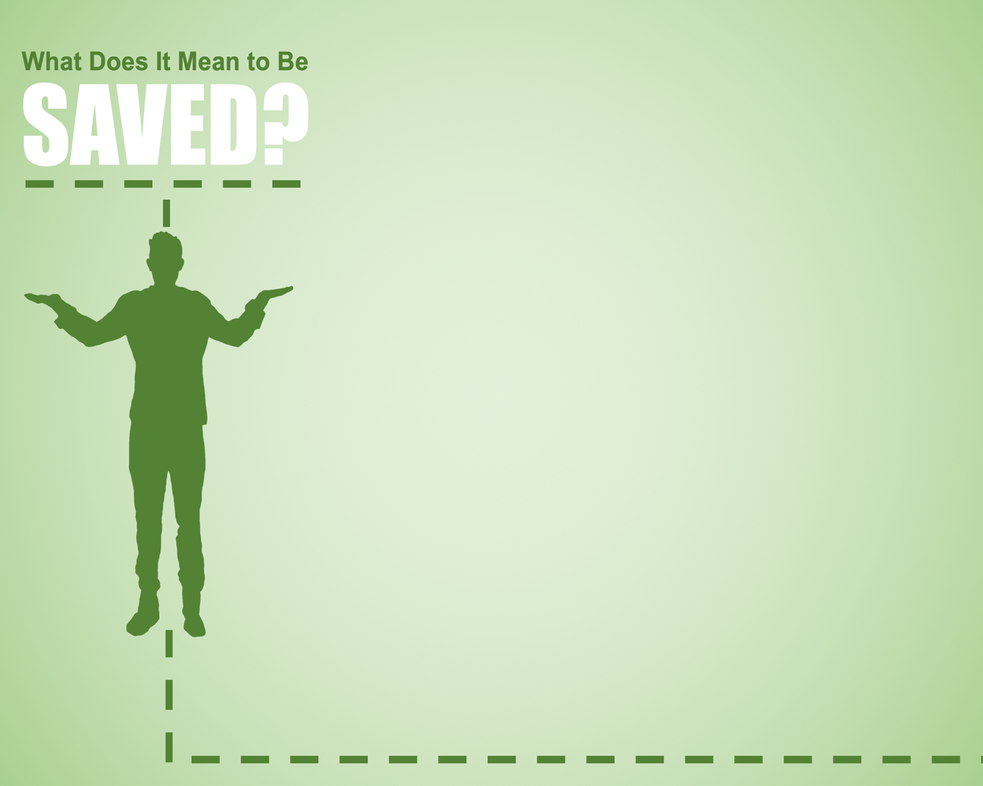
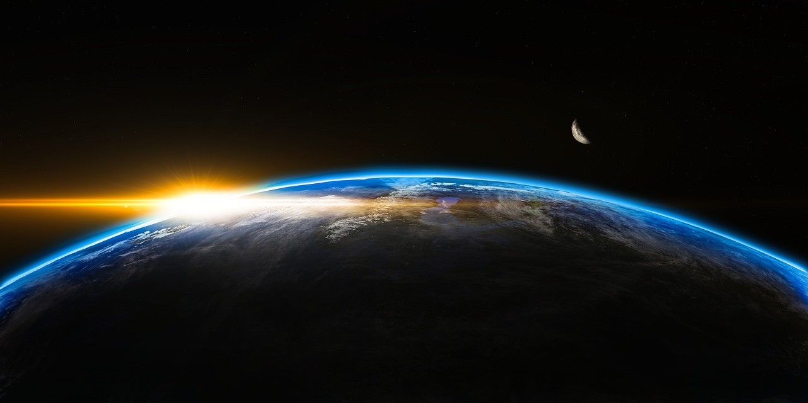
“For God so loved the world, that he gave his only Son, that whoever believes in him should not perish but have eternal life.
John 3:16

Slide 2
The God Who Loves
The World that Perishes
The Son Who Was Given
The Savior Who Lives
The Gift He Gives

Slide 4
It Means You Are a Disciple

Slide 5
It Means You Are a Disciple
“Go therefore and make disciples of all nations, baptizing them in the name of the Father and of the Son and of the Holy Spirit, teaching them to observe all that I have commanded you. And behold, I am with you always, to the end of the age.”
[Matthew 28:29-20]

Slide 6
It Means You Are a Disciple
Disciple
A student of
A follower of
An imitator of

Slide 7
It Means You Are a Disciple
Reflective Questions:

Slide 8
It Means You Are a Disciple
Reflective Questions:
Am I reading the Bible regularly?
Am I contemplating it?
Anticipating studies and discussions of?

Slide 9
It Means You Are Different

Slide 10
It Means You Are Different
Different = Holy

Slide 11
It Means You Are Different
Different = Holy
Abstain from every form of evil.
[1 Thessalonians 5:22]

Slide 12
It Means You Are Different
2 Things are involved:

Slide 13
It Means You Are Different
2 Things are involved:
Being conformed to Christ

Slide 14
It Means You Are Different
2 Things are involved:
Being conformed to Christ
For those whom he foreknew he also predestined to be conformed to the image of his Son, in order that he might be the firstborn among many brothers.
[Romans 8:29]

Slide 15
It Means You Are Different
2 Things are involved:
Being conformed to Christ
It is always good to be made much of for a good purpose, and not only when I am present with you, my little children, for whom I am again in the anguish of childbirth until Christ is formed in you!
[Galatians 4:18-19]

Slide 16
It Means You Are Different
2 Things are involved:
Being conformed to Christ
Therefore be imitators of God, as beloved children. And walk in love, as Christ loved us and gave himself up for us, a fragrant offering and sacrifice to God.
[Ephesians 5:1-2]

Slide 17
It Means You Are Different
2 Things are involved:
Being conformed to Christ
“Paul is not looking for a few minor alterations … but for such a transformation that to see them would be to see Christ.”
[Leon Morris]

Slide 18
It Means You Are Different
2 Things are involved:
Being conformed to Christ
“The Father sent the Son to earth not only to die that men might be saved but also to live as the divine example for those who are saved.”
[John MacArthur]

Slide 19
It Means You Are Different
2 Things are involved:
Displaying that walk through obedience

Slide 20
It Means You Are Different
2 Things are involved:
Displaying that walk through obedience
“…but I do as the Father has commanded me, so that the world may know that I love the Father.”
[John 14:31]

Slide 21
It Means You Are Different
2 Things are involved:
Displaying that walk through obedience
Jesus answered him, “If anyone loves me, he will keep my word, and my Father will love him, and we will come to him and make our home with him.
[John 14:23]

Slide 22
It Means You Are Different
2 Things are involved:
Displaying that walk through obedience
And the world is passing away along with its desires, but whoever does the will of God abides forever.
[1 John 2:17]
[Colossians 3:1-17]

Slide 23
It Means You Are A Servant

Slide 24
It Means You Are A Servant
But Jesus called them to him and said, “You know that the rulers of the Gentiles lord it over them, and their great ones exercise authority over them. It shall not be so among you. But whoever would be great among you must be your servant, and whoever would be first among you must be your slave, even as the Son of Man came not to be served but to serve, and to give his life as a ransom for many.”
[Matthew 20:25-28]

Slide 25
It Means You Are A Servant
If I then, your Lord and Teacher, have washed your feet, you also ought to wash one another's feet.
[John 13:14]

Slide 26
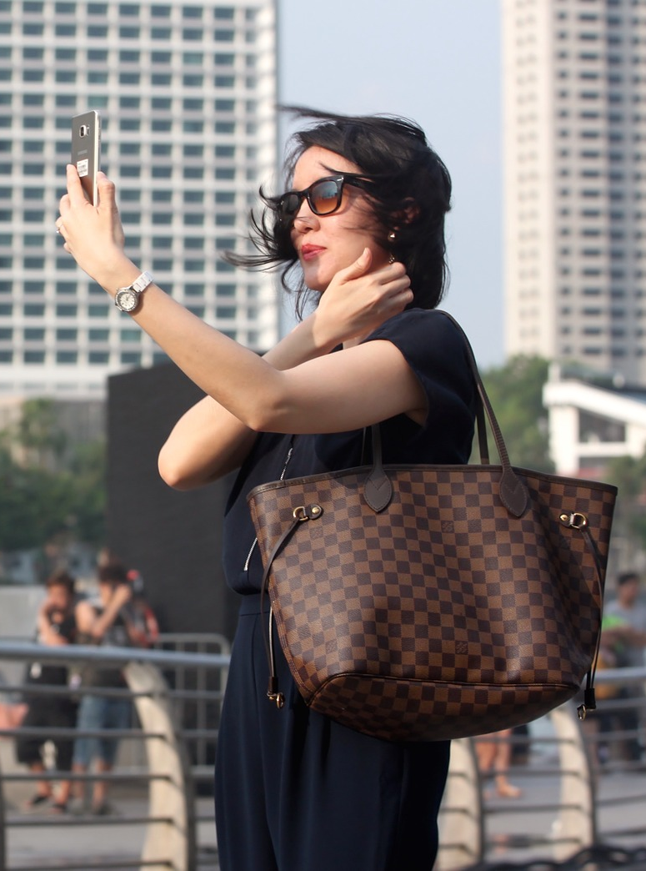


It Means You Are A Servant
If I then, your Lord and Teacher, have washed your feet, you also ought to wash one another's feet.
[John 13:14]

Slide 27
It Means You Are A Servant
Love one another with brotherly affection. Outdo one another in showing honor…. Contribute to the needs of the saints and seek to show hospitality.
[Romans 12:10,13]

Slide 28
It Means You Are A Servant
“How do I serve? What is there to do?”

Slide 29
It Means You Are A Servant
“How do I serve? What is there to do?”
Greet one another

Slide 30
It Means You Are A Servant
“How do I serve? What is there to do?”
Greet one another
Pray for your brethren

Slide 31
It Means You Are A Servant
“How do I serve? What is there to do?”
Greet one another
Pray for your brethren
Break out of the building

Slide 32
It Means You Are A Servant
Brothers, if anyone is caught in any transgression, you who are spiritual should restore him in a spirit of gentleness. Keep watch on yourself, lest you too be tempted. Bear one another's burdens, and so fulfill the law of Christ.
[Galatians 6:1-2]

Slide 33
It Means You Are His Child

Slide 34
It Means You Are His Child
See what kind of love the Father has given to us, that we should be called children of God; and so we are. The reason why the world does not know us is that it did not know him.
[1 John 3:1]

Slide 35
It Means You Are His Child
For you did not receive the spirit of slavery to fall back into fear, but you have received the Spirit of adoption as sons, by whom we cry, “Abba! Father!”
[Romans 8:15]

Slide 36
It Means You Are His Child
If you know that he is righteous, you may be sure that everyone who practices righteousness has been born of him.
[1 John 2:29]

Slide 37
It Means You Are His Child
Being His child means:

Slide 38
It Means You Are His Child
Being His child means:
He accepts me

Slide 39
It Means You Are His Child
Being His child means:
He accepts me
He is close to me

Slide 40
It Means You Are His Child
Being His child means:
He accepts me
He is close to me
For you did not receive the spirit of slavery to fall back into fear, but you have received the Spirit of adoption as sons, by whom we cry, “Abba! Father!”
[Romans 8:15]

Slide 41
It Means You Are His Child
Being His child means:
He accepts me
He is close to me
He gives me a new identity

Slide 42
It Means You Are His Child
Being His child means:
He accepts me
He is close to me
He gives me a new identity
He mentors me

Slide 43
It Means You Are His Child
Being His child means:
He accepts me
He is close to me
He gives me a new identity
He mentors me
For all who are led by the Spirit of God are sons of God. [Romans 8:14]

Slide 44
It Means You Are a Disciple
It Means You Are Different
It Means You Are A Servant
It Means You Are His Child

