Slide 1
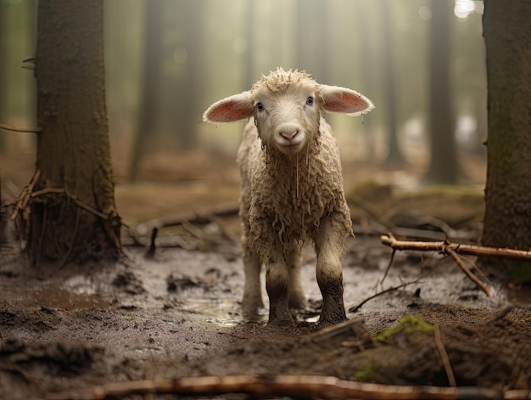
Sheep Without a Shepherd
Mark 6:34 – “When Jesus went ashore, He saw a large crowd, and He felt compassion for them because they were like sheep without a shepherd; and He began to teach them many things.”
What did Jesus see?
How did He feel about it?
What did He do about it?

